Slide 1
Emerging Technologies for
Economy and Enhanced Safety
Arun Kumar Bhaduri
Indira Gandhi Centre for Atomic Research,
Kalpakkam, Tamilnadu
11th Nuclear Energy Conclave
18th October 2019, New Delhi

Slide 2
Small & Medium Reactors (SMRs)
IAEA Classification of SMRs based on Power Output
  Small Reactors: < 300 MWe
  Medium Reactors: 300–700 MWe
SMRs ideal for
  Large energy demand coupled with poor infrastructure & small grids
  Limited investment capability
  Possible spread of investment over time
    Modularization & deployment in increments
  Non-power generating applications
    Desalination, hydrogen production, process heat applications, etc.
  Deployment in remote areas with sizes catering only to local demand
  Consolidation & gaining knowledge of technology at smaller scale
  Reduced risk of new technology before scaling to large size reactors
  Design without need for refueling (proliferation resistant)

Slide 3
Benefits of SMR
Avoid accidents like TMI, Chernobyl & Fukushima
  Augmenting / reinforcing existing safety provisions to avoid severe accidents
Need to practically eliminate dose release to public
  Prescribed in emerging safety criteria
    Improved core design
    Passive safety features
    Strengthening containment integrity
Low initial capital investment compared to large power reactors
Less construction time as repeat units
Deployment as multiple units at a site (nuclear park)
Modular designs
  Factory built and transported to site
  Direct erection keeping site works to a minimum

Slide 4
Fast Reactor based SMRs
IAEA has formed a technical working group on SMRs
~50 SMR designs being pursued worldwide for varied applications
  Water cooled reactors
  High temperature gas cooled reactors
  Fast reactors
  Molten salt reactors
Fast reactors
  Sodium cooled reactor (SFR)
  Lead / lead alloy cooled reactor (LFR)
SFR can be designed with
  Low coolant void coefficient
  Additional Active & Passive safety features for Shutdown & Decay heat removal
    Greater potential to practically eliminate severe accidents
  Provision of containment serves as additional protection to public

Slide 5
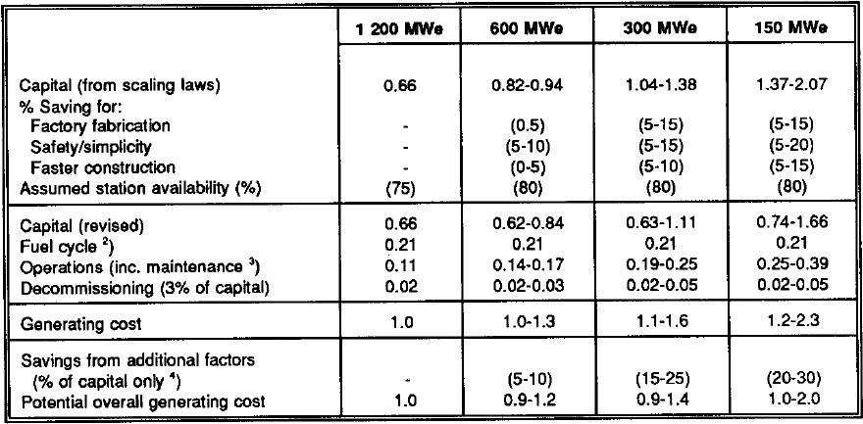
Economics of SMRs
SMRs of 300-600 MWe have competitive economics with 1200 MWe units (based on UKAEA study)
  Source: Small and Medium Reactors – Status and Prospects, Report by an Expert Group, NEA/OECD, Paris (1991)

Slide 6
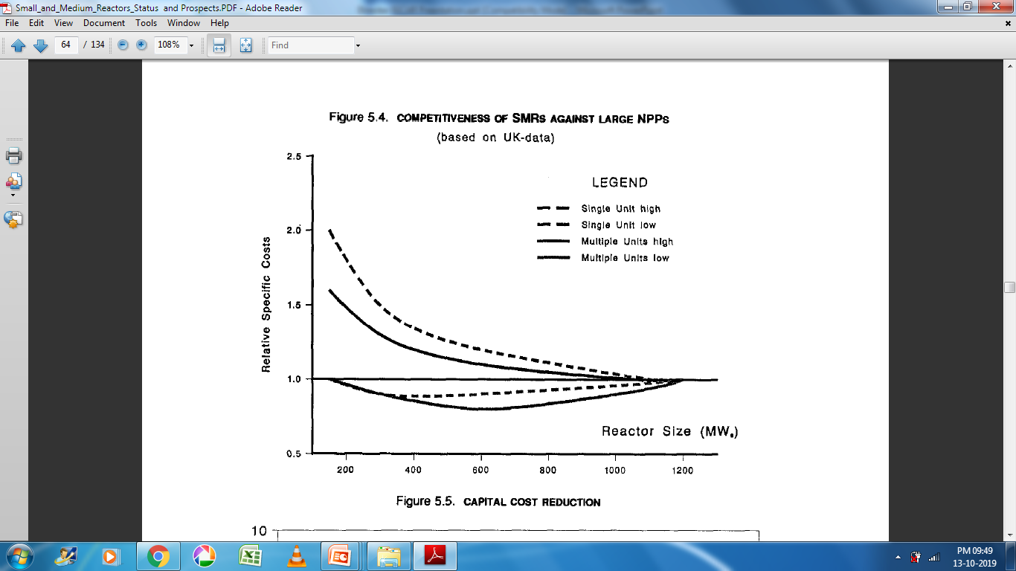
Economics of SMRs
SMR’s Cost Competitiveness against Large NPPs
(based on an UK Study)
Source: Small and Medium Reactors – Status and Prospects, Report by an Expert Group, NEA/OECD, Paris (1991)

Slide 7
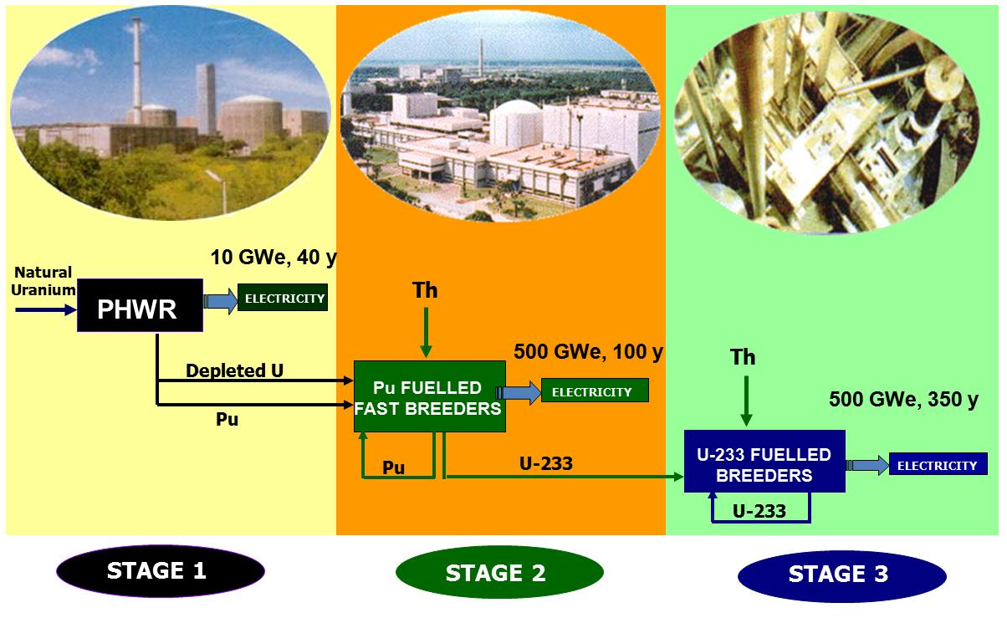
India’s Three Stage Nuclear Power Programme

Slide 8
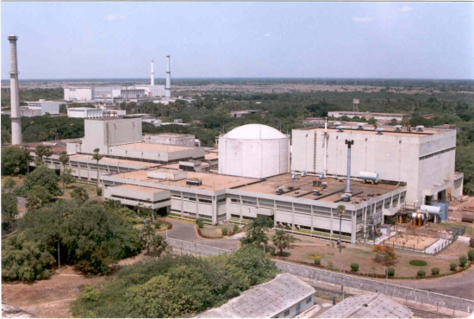
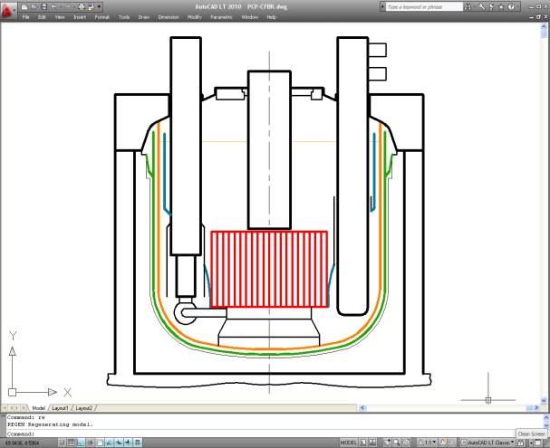
Indian Fast Breeder Reactor (FBR) Programme
FBTR
40 MWt
13.5 MWe
Loop type
PuC – UC
Design: CEA
Since 1985
FBR 1 - 6
500/600 MWe
Pool Type
UO₂-PuO₂
3 twin units
Indigenous
2029 - 2039
PFBR
1250 MWt
500 MWe
Pool Type
UO₂-PuO₂
Indigenous
From 2021..
Metal fuel based FBR
100 MWt/1000 MWe
Loop / Pool Type
Metallic fuel
Indigenous
Beyond 2031/2039
FBR program started with FBTR
Prototype &Technology Demonstration: PFBR
6 more Mixed Oxide (MOX) fuelled reactors (FBR 1–6) after PFBR
Metal Fuelled Reactors thereafter
  Metal fuelled Test Reactor & 1000 MWe Power Reactors
PFBR & FBR 1-6 fall in the SMR power range

Slide 9
Measures to Further Improve Safety of FBRs
Thermal Reactors
  Loss of coolant accident (LOCA) is governing accident
  Main steam line break (MSLB) also leads to serious reactor core safety issues
Fast Breeder Reactors
  Primary system pressures are very low
  Loss of coolant is not a serious issue, especially in pool type reactors
  Secondary sodium system is non-radioactive
  Heat removed is directly from primary system through dedicated systems
  Steam line break not is a safety issue

Slide 10
Measures to Further Improve Safety of FBRs
Fast Breeder Reactors
  Source for severe accidents linked to Anticipated Transients Without Scram (ATWS) where possibility of reactivity addition is coupled with insufficient heat removal
    Failure to shutdown + uncontrolled withdrawal of one control rod
      Unprotected Transient Over-Power (UTOP)
    Failure to shutdown + loss of flow through the core
      Unprotected Loss of Flow (ULOF)
  UTOP & ULOF lead to energetic core accidents which have to be practically eliminated
  Loss of heat sink is also a serious situation especially when it is unprotected / coupled with failure of reactor shutdown (ULOHS)
  Additional Active & Passive measures would avoid these type of situations in FBRs

Slide 11
Improved Safety Features in Shutdown System of FBRs
Objective: Achieve diverse means of achieving shutdown of the reactor
  Normally two shutdown systems are provided
In addition to existing features, some improved add-ons:
  Stroke Limiting Device (SLD) in CSRDM
  [1st shutdown system]
  Temperature Sensitive Magnetic Switch (TSMS) in DSRDM
  [2nd shutdown system]
  Hydraulic Suspended Absorber Rods (HSAR)
  [Additional shutdown feature]
    By providing SLD, TSMS & HSAR in FBRs, it is possible to eliminate ATWS type situations, thereby practically eliminating severe accidents and improving safety

Slide 12
Decay Heat Removal System in FBRs
Decay Heat is heat produced in the reactor core due to radioactive decay of fission products even after reactor shutdown
Decay heat decreases very steeply after reactor shutdown
  From MWt range to few kWt range within ~30 minutes
  Long term rejection of decay heat to ultimate heat sink is required to limit temperatures of coolant & ultimately the reactor structures
For reliable heat removal, multiple paths for heat removal are provided

Slide 13
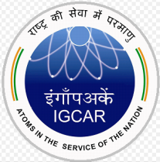
Improving Means of Decay Heat Removal in FBRs
Objective: Achieve diverse means of heat removal from reactor under shutdown & accident conditions
Typical means of decay heat removal in FBRs
  Heat removal through steam water system (Active Mode)
  Direct heat removal from primary sodium through multiple heat exchangers dipped in hot pool (4 loops working in Passive Mode)
Heat removal from alternative paths
  Passively from secondary sodium system
  Passively from outside surface of steam generator shell
  Actively / Passively from outer surface of safety vessel
Additional measures will result in additional cost
  Cost to benefit study has to be made before implementation
Multiple loops of passive decay heat removal & alternate means of heat removal would enable loss of heat sink extremely remote thereby ensuring safety of the reactor

Slide 14
Molten Salt Reactors – Historical Background
Aircraft Reactor Experiment (ARE) at ORNL [1954] proved feasibility of Molten Salt Reactor (MSR) concept
  Power: 2.5 MWt ➢ Overall operation: 1000 MW-hr
  Fuel: 93.4% U-235 ➢ Fuel Salt: NaF-ZrF-UF₄
  Moderator: BeO ➢ Secondary Coolant: Helium
  Coolant outlet: 860ºC ➢ Structural Material: Inconel
Molten Salt Reactor Experiment (MSRE) at ORNL [1964]
  Power: 8 MWt ➢ Operated: 5 years at 85% load factor
  Fuel: 30% U-233 / Pure U-233 / Pu-239
  Fuel Salt: 66%LiF-29%BeF₂-5%ZrF₄-0.2%UF₄
  Moderator: Graphite ➢ Secondary Coolant: LiF-BeF₂
  Coolant outlet: 663ºC ➢ Structural Material: Hastelloy-9
Several design versions of both Thermal and Fast MSRs being pursued worldwide

Slide 15
Molten Salt Reactors
Advantages of MSRs over other reactor types
  Both fuel & coolant are in mixed condition
  Fuel temperatures are less
  Coolant temperatures are higher
    Preferable for improving overall cycle efficiency
  Improved safety due to large temperature margin for coolant (molten salts) to boiling point
  Accident conditions are less severe with fuel-salt mixture
    Fuel salts expand at higher temperatures without any serious consequences
Major Challenge
  Compatibility of molten salt mixture with structural materials
    Requires R&D on materials suitable for life long operation

Slide 16
Summing Up …
Various technological options being pursued worldwide to make nuclear power economically competitive with other energy options & to improve safety to gain wider public acceptance
  Constant efforts being made for improving safety & economy of nuclear reactors
Great interest worldwide on Small & Medium Reactors
  FBRs have been proven to be a viable alternative considering their vast energy potential
    IGCAR serves as nodal centre for carrying out FBR related R&D & to establish FBR technology in India
      Emphasis on providing augmented Active & Passive Safety features for Shutdown & Decay Heat Removal systems to practically eliminate severe accidents
Molten Salt Reactors are an attractive option but require long lead time to reach technological maturity

Slide 17

Thank You

